Slide 1
Macromolecules

Slide 2
Organic Compounds
Compounds that contain CARBON are called organic.
Macromolecules are large organic molecules.

Slide 3
Carbon (C)
Carbon has 4 electrons in outer shell.
Carbon can form covalent bonds with as many as 4 other atoms (elements).
Usually with C, H, O or N.
Example: CH₄(methane)

Slide 4
Macromolecules
Large organic molecules.
Also called POLYMERS.
Made up of smaller “building blocks” called MONOMERS.
Examples:
1. Carbohydrates
2. Lipids
3. Proteins
4. Nucleic acids (DNA and RNA)

Slide 5
Question: How are Macromolecules separated or digested?

Slide 6
Answer: Hydrolysis
Separates monomers by “adding water”
Catabolic Reaction:Releases energy by breaking down larger molecules into smaller molecules.
HO
H
H₂O
HO
H
HO
H

Slide 7
Question: How Are Macromolecules Formed?

Slide 8
Answer: Dehydration Synthesis
Also called “condensation reaction”
Forms polymers by combining monomers by “removing water”.
Anabolic Reaction: uses energy released by catabolic pathways to build larger molecules from smaller molecules
HO
H
HO
H
H₂O
HO
H

Slide 9
Carbohydrates

Slide 10
Carbohydrates
Small sugar molecules to large sugar molecules.
Examples:
A. monosaccharide
B. disaccharide
C. polysaccharide

Slide 11
Carbohydrates
Monosaccharide: one sugar unit
Examples: glucose (C₆H₁₂O₆)
deoxyribose
ribose
Fructose
Galactose
glucose

Slide 12
Carbohydrates
Disaccharide: two sugar unit
Examples:
Sucrose (glucose+fructose)
Lactose (glucose+galactose)
Maltose (glucose+glucose)
glucose
glucose

Slide 13
Carbohydrates
Polysaccharide: many sugar units
Examples: starch (bread, potatoes)
glycogen (beef muscle)
cellulose (lettuce, corn)
glucose
glucose
glucose
glucose
cellulose
glucose
glucose
glucose
glucose

Slide 14
Lipids

Slide 15
Lipids
General term for compounds which are not soluble in water.
Lipids are soluble in hydrophobic solvents.
Remember: “stores the most energy”
Examples: 1. Fats
2. Phospholipids
3. Oils
4. Waxes
5. Steroid hormones
6. Triglycerides

Slide 16
Lipids
Six functions of lipids:
1. Long term energy storage
2. Protection against heat loss (insulation)
3. Protection against physical shock
4. Protection against water loss
5. Chemical messengers (hormones)
6. Major component of membranes (phospholipids)

Slide 17
Lipids
Triglycerides: composed of 1 glycerol and 3 fatty acids.
H
H-C----O
H-C----O
H-C----O
H
O
C-CH₂-CH₂-CH₂-CH₂-CH₂-CH₂-CH₂-CH₂-CH₂-CH₃
=
O
C-CH₂-CH₂-CH₂-CH₂-CH₂-CH₂-CH₂-CH₂-CH₂-CH₃
=
O
C-CH₂-CH₂-CH₂-CH
fatty acids
=
=CH-CH₂-CH₂-CH₂-CH₂-CH₃
glycerol

Slide 18
Fatty Acids
There are two kinds of fatty acids you may see these on food labels:
1. Saturated fatty acids: no double bonds (bad)
2. Unsaturated fatty acids: double bonds (good)
O
C-CH₂-CH₂-CH₂-CH₂-CH₂-CH₂-CH₂-CH₂-CH₂-CH₃
=
saturated
O
C-CH₂-CH₂-CH₂-CH
=
unsaturated
=CH-CH₂-CH₂-CH₂-CH₂-CH₃

Slide 19
Proteins

Slide 20
Proteins (Polypeptides)
Amino acids (20 different kinds of aa) bonded together by peptide bonds (polypeptides).
Six functions of proteins:
1. Storage: albumin (egg white)
2. Transport: hemoglobin
3. Regulatory: hormones
4. Movement: muscles
5. Structural: membranes, hair, nails
6. Enzymes: cellular reactions

Slide 21
Proteins (Polypeptides)
Four levels of protein structure:
A. Primary Structure
B. Secondary Structure
C. Tertiary Structure
D. Quaternary Structure

Slide 22
Primary Structure
Amino acids bonded together by peptide bonds (straight chains)
Amino Acids (aa)
aa1
aa2
aa3
aa4
aa5
aa6
Peptide Bonds

Slide 23
Secondary Structure
3-dimensional folding arrangement of a primary structure into coils and pleats held together by hydrogen bonds.
Two examples:
Alpha Helix
Beta Pleated Sheet
Hydrogen Bonds

Slide 24
Tertiary Structure
Secondary structures bent and folded into a more complex 3-D arrangement of linked polypeptides
Bonds: H-bonds, ionic, disulfide bridges (S-S)
Call a “subunit”.
Alpha Helix
Beta Pleated Sheet

Slide 25
Quaternary Structure
Composed of 2 or more “subunits”
Globular in shape
Form in Aqueous environments
Example: enzymes (hemoglobin)
subunits

Slide 26
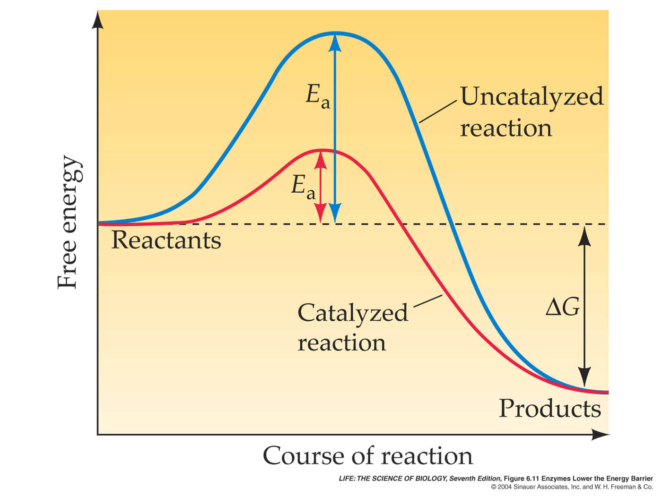
Effects of Enzymes

Slide 27
Success Point Giveaway!! (2-01)

Slide 28
Success Point Giveaway!! (2-01)
Finish the phrase: Enzymes speed up chemical reactions by…..
2) What are the two types of secondary structures of proteins?

Slide 29
Nucleic Acids

Slide 30
Nucleic acids
Two types:
a. Deoxyribonucleic acid (DNA- double helix)
b. Ribonucleic acid (RNA-single strand)
Nucleic acids are composed of long chains of nucleotides linked by dehydration synthesis.

Slide 31
Nucleic acids
Nucleotides include:
phosphate group
pentose sugar (5-carbon)
nitrogenous bases:
adenine (A)
thymine (T) DNA only
uracil (U) RNA only
cytosine (C)
guanine (G)

Slide 32
Nucleotide
Phosphate
Group
O
O=P-O
O
5
CH2
O
N
Nitrogenous base
(A, G, C, or T)
C⁴
C¹
Sugar
(deoxyribose)
C³
C²

Slide 33
DNA - double helix
5
O
3
3
O
P
5
P
5
O
G
C
1
2
3
4
4
2
1
3
5
P
O
P
T
A
3
5
O
O
5
P
P
3

